Slide 1
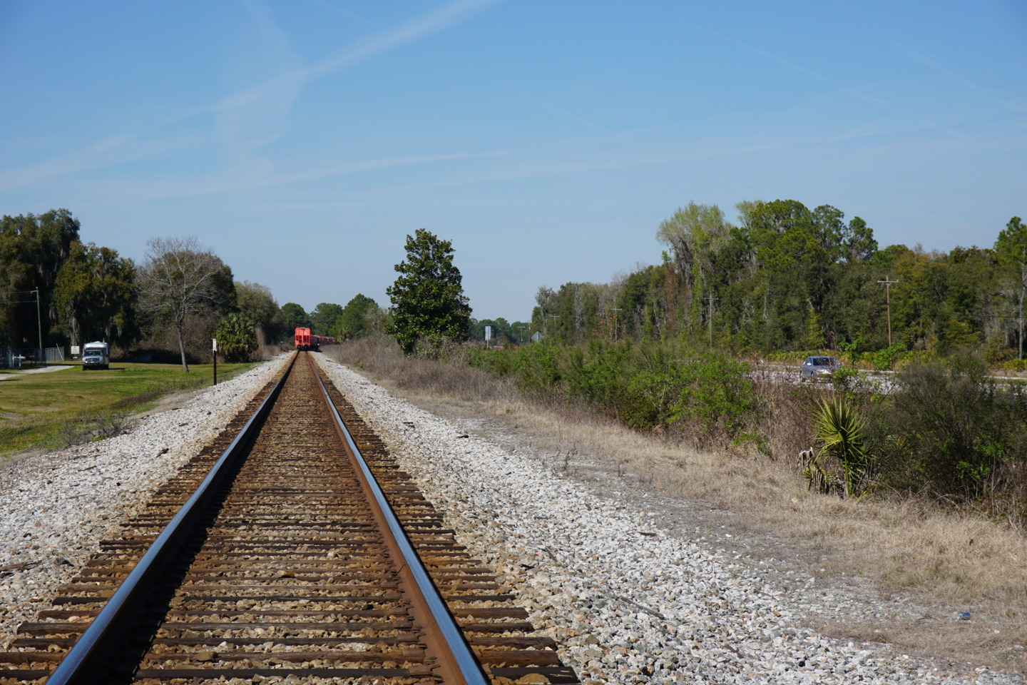


5G Exchange Open Coopetative Ecosystem The Concept
END USERS AROUND THE GLOBE
INFRASTRUCTURE PROVIDERS
OTHER SERVICE PROVIDERS
A virtualized infrastructure orchestration system spanning multiple infrastructure providers.
It enables Enlarging Service Coverage and Enriching Service Portfolio of the involved service providers.

Slide 2
5g Exchange Open Coopetative Ecosystem Enlarged Service Coverage
Default Service Provider’s Coverage Area
Partner Service Provider’s Coverage Area
The ecosystem makes it possible for end users to have the same user experience both in terms of functionality and service characteristics independent of their location or consumption worldwide.
This is achieved by automated resource sharing among infrastructure or online providers.
If the end user demands a service at a new location where the infrastructure is not owned by the default provider then the default provider may automatically lease resources from other providers to fulfill the service request at the desired location.
Default Service Provider’s Infrastructure
Partner Service Provider’s Infrastructure
Service resources
Service resources

Slide 3
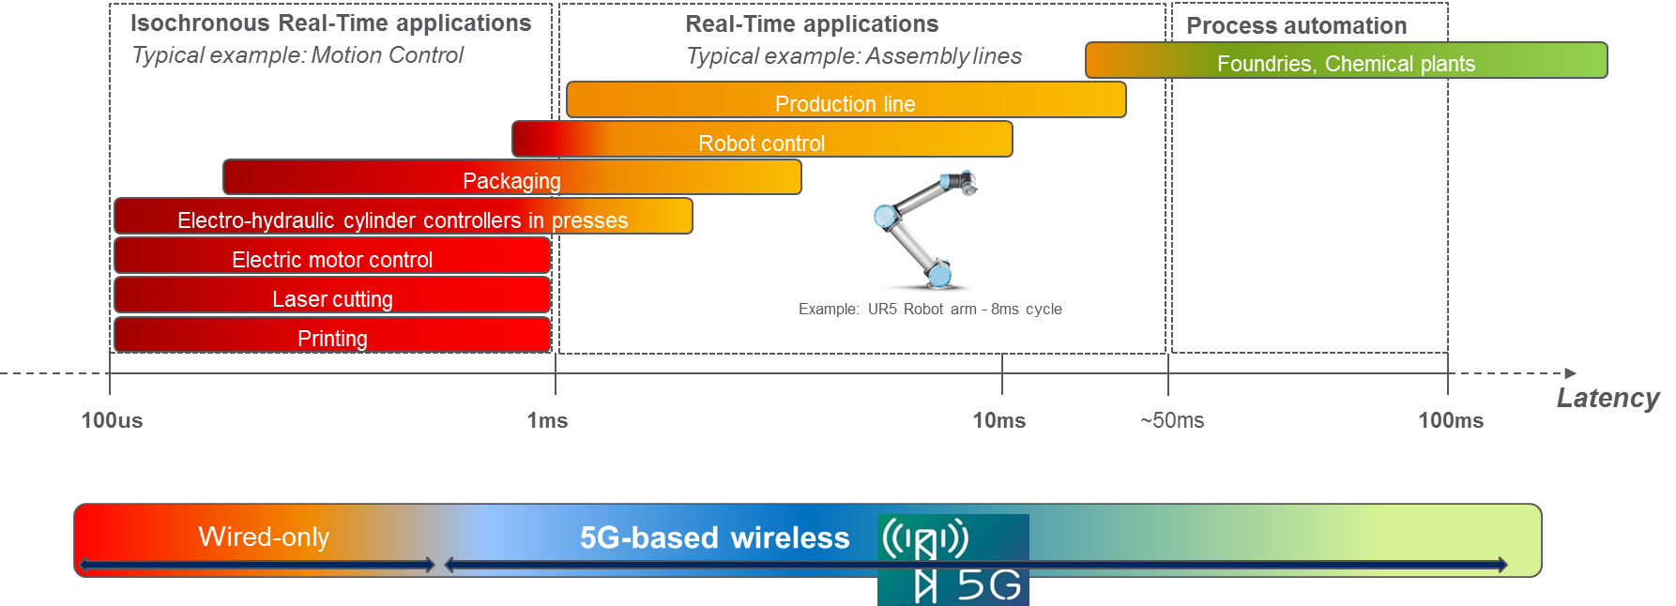
Critical Machine Type Communication 5G Radio & CORE for Latency Guarantees

Slide 4
Cloud-enabled Factory Control For Complex & Cooperative Tasks, Scalability & Flexible Reconfiguration
~2-8ms cycle time is needed for the safe operation
Ultra-low Latency is critical for process operation: delay limit violation or/and delay variation causes serious service degradation/collapse
Deployment of virtualized Control functions has to fulfill the latency requirements
High reliability is required to avoid unnecessary service collapse in case of a failure on the communication path
Target Fault tolerance level can only be guaranteed by the proper isolation of networking and compute resources
Orchestration solution is needed for
integrated and automated handling of the (virtualized) compute and networking resources,
with fulfillment of latency and reliability requirements
considering multi-domain, multi-provider environment

Slide 5
Multi-Provider Factory Automatization A Showcase for NFV Orchestration
International provider
Factory premise:
Industry Cloud with computing and networking resources managed by the Factory owner + Orchestrator
5G-based Local network (including radio, transport, required core entities) deployed and managed by the Regional Provider + Orchestrator
Ultra-low latency is provided among devices/functions deployed at Factory premise
Reginal provider with orchestrated networking and compute resources
Higher delay has to be considered towards Factory premise
International Provider
Top orchestrator: integration of Regional Providers
Cloud-enabled Factory Automation control: e.g. PLC as VNF
Can be deployed on Factory local or remote sites depending on latency, reliability requirements of the service
Multi-operator, Multi-domain hierarchical Orchestration
Integrated and automated resource handling
Latency and reliability requirements are considered
Orchestration
Factory premise
Regional provider
Network is managed by the Regional Operator
Orchestration
Orchestration
SDN
SDN
Latency=10ms
Latency=10ms
SDN
Orchestration
Latency=5ms
Latency=2ms
SDN
vCtrl
Industry Cloud deployment
vCtrl
vCtrl

Slide 6
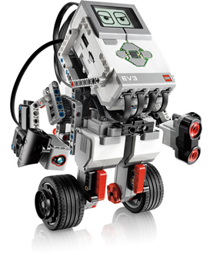
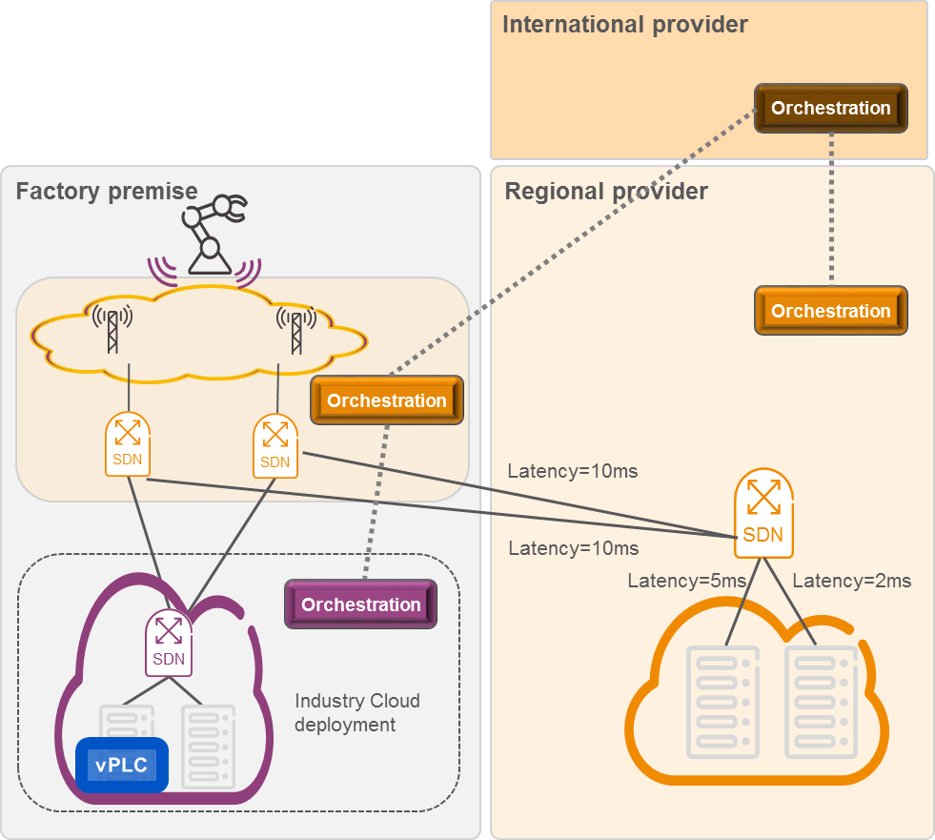
Demo details
Demo setup
Balancing Robot (as Industry Device)
SDN domains realized by Mikrotik SDN switches
Two WLAN Aps (TP-Link)
WiFI AP1
WiFI AP2
Mikrotik switch_1
Mikrotik switch_2
Eth 3
Eth 3
SDN1
Eth 4
Eth 4
SDN2
Eth 5
Eth 5
Eth 6
Eth 6
SDN3
Eth 7
Eth 7
SDN4
Eth 8
Eth 8
Eth 9
Eth 9
1
2
3
4
4 Docker domains running on different blades of a TranquilPC cluster server
Represents Factory and Remote domain
vCont
Factory premise
Remote domain
Robot Balancing Control function (vCont) running on a Docker container

Slide 7
Case 1: Controller deployment with ultra low latency
International provider
Service request
Req: ultra low latency
Orchestration
vCont_1
Factory premise
Regional provider
vCont_2
Req: ultra low latency
Network is managed by the Regional Operator
Orchestration
Service request: strict latency, but low reliability requirement
Only duplicated Controller functions required
Orchestration is done by considering latency requirement
Low reliability level
Fault tolerance to software errors (e.g. vContr failure)
Partial tolerance to network failures (partially isolated network paths)
Datacenter hardware error is critical
Orchestration
SDN
SDN
Latency=10ms
Latency=10ms
SDN
Orchestration
Latency=5ms
Latency=2ms
SDN
vCont_1
Industry Cloud deployment
vCont_2
DC3
DC4
DC1
DC2

Slide 8
Case 2: Reliable controller deployment
International provider
Service request
Req: ultra low latency
Orchestration
vCont_1
Req: Anti-affinity
Factory premise
Regional provider
vCont_2
Req: ultra low latency
Network is managed by the Regional Operator
Orchestration
Service request: strict latency, moderate reliability requirement
Orchestration is done by considering latency + reliability requirement
Middle reliability level
Fault tolerance to software and datacenter hardware errors (e.g. vContr failure)
Partial tolerance to network failures (partially isolated network paths)
Orchestration
SDN
SDN
Latency=10ms
Latency=10ms
SDN
Orchestration
Latency=5ms
Latency=2ms
SDN
vCont_1
Industry Cloud deployment
vCont_2

Slide 9
Case 3: end-to-end reliability
International provider
Service request
Req: ultra low latency
Orchestration
vCont_1
Req: End-to end reliability
Factory premise
Regional provider
vCont_2
Req: relaxed latency
Network is managed by the Regional Operator
Orchestration
Service request: end-to-end reliability, relaxed latency requirement on backup path
Trade-off between latency and reliability
Orchestration is done by considering latency + reliability requirement
High reliability level: fault tolerance to any single failure
Total resource isolation
Orchestration
SDN
SDN
Latency=10ms
Latency=10ms
Latency=10ms
SDN
Latency=10ms
Latency=5ms
Orchestration
Latency=5ms
Latency=2ms
SDN
vCont_1
Industry Cloud deployment
vCont_2

Slide 10




















Horizon 2020/ 5G-PPP / 5G Exchange PROJECT INFORMATION
Coordinated by Ericsson
5 operators, 5 vendors, 5 Universities, 3 SMEs
1,032 Person Months
8 MEUR grant
October 2016 – June 2018
http://www.5gex.eu/
Contact: robert.szabo@ericsson.com
Standardization activities
Coordinated by
Notes:
This experiment focuses on UC-6 Network Slicing and UC-9 GILAN / Roaming. The challenges consist of a service-related and an infrastructure-related part. For the service-related part, we want to demonstrate (a) the extension of an existing Evolved Packet Core (EPC)) in a data centre of operator A into the data centre of another mobile network operator (operator B) and the connection to the SGW of operator B. Furthermore (b), we want to show the deployment of typical GiLAN services (i.e. services typically residing in the GiLAN) such as CDN. This experiment thus needs an infrastructure-related requirement that is the creation of a cross-operator slice consisting of an end-to-end mix of compute, network and storage resources.
In the experiment, we will deploy a virtual EPC (e.g., OpenEPC) via a cloud orchestration template (e.g., OpenStack Heat) in the home (operator A) and the guest OpenStack (operator B) and spawn GiLANs. In the next step a connection between both GiLANs is established (e.g., via BGP VPN – Exp3). We will use user equipment (UE) emulated in an OpenEPC VM to connects/disconnect. Furthermore, we plan to show the synchronization of data bases (e.g., HSS – Home Subscriber Server).

Slide 11

Resource orchestration of reliable c-MTC services Integrated and automated handling of network and compute resources by considering reliability and low-latency requirement
Credit:
J. Harmatos, D. Jocha, R. Szabó, B. Gerő (Ericsson) B. Németh, J. Czentye, B. Sonkoly (BME)

