Slide 1
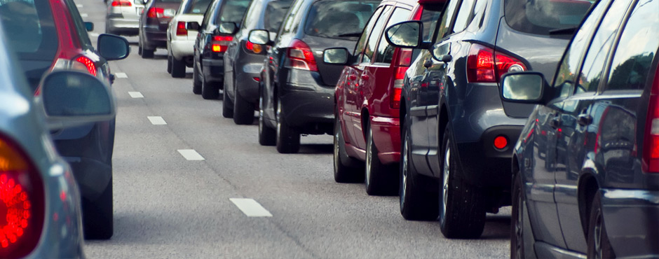
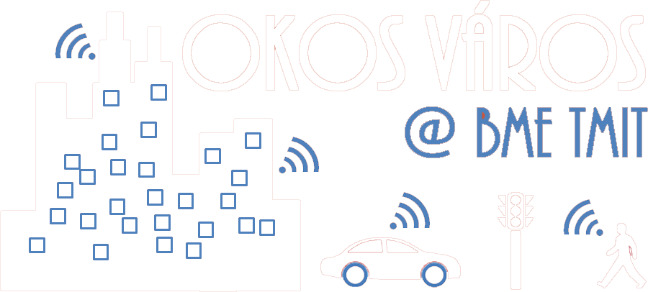
Mobility and MANET Intelligent Transportation Systems
Rolland Vida

Slide 2
Restricted directional flooding
Location-Aided Routing (LAR)
Use the position information of the destination node to limit the flooding
Introduces the notion of Expected Zone
The zone where the destination is expected to be
Estimation, based on the previous location of the destination, its speed and direction information
RREQ messages forwarded only inside a Request Zone
The Request Zone includes the Expected Zone, together with the area linking the source with the Expected Zone

Slide 3
LAR Expected Zone, Request Zone
X = the last known position of the destination D, at time t₀
Y = the current position of the destination node D at time t₁ (S is not aware of it)
r = (t₁ - t₀) * [estimated speed of D]
Request Zone
X
r
X
r
Y
B
A
Y
Expected Zone
S

Slide 4
LAR Request Zone (2)
RREQ messages forwarded only inside the Request Zone
The Request Zone might be the smallest rectangle including the source and the Expected Zone
E.g., in the example, B forwards the RREQ, but A does not
The Request Zone explicitly defines whether the RREQ message should be dropped or not
Each node knows its own position, knows if it is inside the Request Zone or not

Slide 5
LAR Request Zone (3)
If the source did not estimate well the position of the destination, the Request Zone might not contain it → the route discovery will fail!
After a timeout, the source starts a new search…
Increases the size of the Request Zone;
If needed, the entire network is included in the Request Zone
The following steps of LAR are similar to DSR
In the RREQ message we include the path, step by step
The destination sends back a RREP, following this path
The path is then included in the header of the data packet
Routes have to be refreshed from time to time

Slide 6
LAR versions: Adaptive Request Zone
The Request Zone stored in the RREQ can be modified by each internal node, if
It has fresher information about the destination
AND the resulting Request Zone is included in the original one
B
S
Request zone created by B
Original Request zone determined by S

Slide 7
LAR overview
Advantages
The area of spreading of the RREQ message is limited
Smaller overhead for route discovery
Drawbacks
Nodes have to know their location

Slide 8
Distance Routing Effect Algorithm for Mobility (DREAM)
Uses information about position and speed (as in LAR) for reducing the area flooded with data packets
Data is distributed by flooding, as opposed to LAR, where we only use flooding to discover the best route

Slide 9
DREAM localization
1. Expected zone
(„as in LAR”)
2. Data is flooded inside a cone where S is the apex, the expected zone is the base
D
A
S
3. Node A limites the flooding inside a cone where A is the apex

Slide 10
DREAM distance effect
Nodes periodically broadcast their position
„Distance effect” = Remote nodes move with a smaller angular speed.
→ Close nodes should refresh their data more often
Playing with the time-to-live (TTL) field
Adaptive TTL

Slide 11
CBF (Contention Based Forwarding)
In position-based routing solutions a node learns about the position of its neighbors via periodic beacon messages
Mobility and energy-efficiency should be taken into account when calculating the frequency of beaconing
Proposal CBF (Contention Based Forwarding)
Greedy forwarding, without any knowledge on the position of the neighbors
Distributed next hop selection, hop-by-hop
Advantages:
Each node has to know only its own position
No burden on the network because of the beacon (hello) messages
Comment: In some cases, if local maximum is reached, recovery mode might have to be activated, but this is a different problem.

Slide 12
Contention Based Forwarding
How it works:
The next hop is selected based on a contest
Suppression: lowers the probability of collisions, as normally just one node is selected as next hop
Steps:
The source broadcasts the message to its neighbors.
Each node sets a timer for its own retransmission
The timer inversely proportional to the distance form the source
The timer of the furthest away node will expire first
He retransmits, all the others hear it, and cancel their own retransmission
Decentralized selection of the next hop

Slide 13
Vehicle-to-vehicle communication
„Traditional” ad hoc protocols:
Proactive: DSDV (not detailed)
High signalling to build and maintain routes that will constantly change in case of cars
Reactive: AODV, DSR
Slow topology discovery and route setup
Not efficient for cars, as they move faster
Position-based: LAR, DREAM
Needs localization service
In some cases it leads to local maximums, needs a recovery mode
In urban scenarios there is a high chance for such local maximums, the physical distance is not so relevant when many buildings obstructing the communication
New solutions needed for vehicle-to-vehicle (V2V) communication

Slide 14
AODV versions for VANETs
AOMDV: Multipath
Not only one path is stored, but all those that were discovered
This can be done without extra burden, as the path discovery is anyhow based on flooding
If the primary path is broken, we can switch rapidly to a back-up path
We need to search for new paths only if all the previously known paths are broken (or their number is getting very low)
SD-AOMDV: Speed and Direction
The speed and direction of nodes is taken into account when selecting the best path out of the discovered ones
A node can be next hop only if it goes in the same direction, with roughly the same speed
R-AOMDV: Retransmission count
Takes into account the quality of the links, besides the hop count
Link quality: number of retransmissions at MAC layer, until a successful retransmission
Problem: link quality changes rapidly
Cross-layer optimization – information from lower layers is used for routing at networking layer

Slide 15
AODV versions for VANETs
AODV+PGB: Preferred Broadcast Group
If the next hop is too close, the message does not advance rapidly
If the next hop is too far, there is a high chance for the link to break
Proposal: select as next hop nodes which are at a medium distance (the signal strength is average), they will form the Preferred Group
BAODV: Bus-AODV
P-AODV
I-AODV
Improved-AODV
AODV-BD
AODV-VANET
etc.

Slide 16
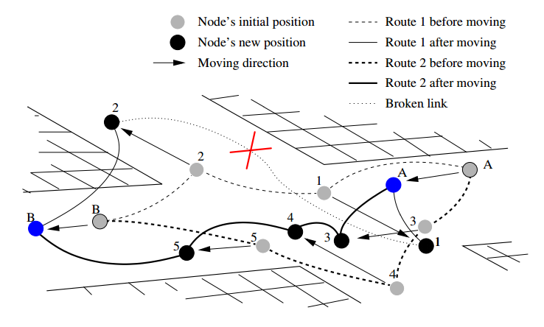
Link-stability based routing
Movement Prediction based Routing (MOPR)
Takes into account the position, speed and direction of the cars
Builds routes with nodes that move in similar ways

Slide 17
DTN: Delay Tolerant Network
If nodes are sparse, the network connectivity can be broken
Topology holes will appear
This can be handled by the carry-and-forward method
Data-mules
It is possible if the message is still valid in spite of the delay
Mobility prediction is very useful

Slide 18
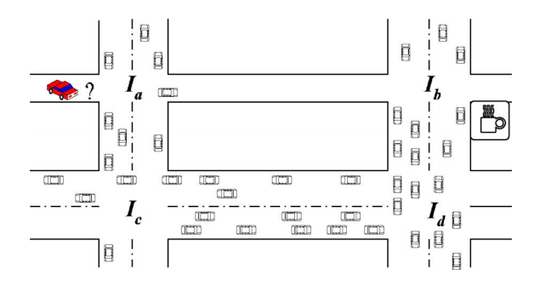
VADD: Vehicle-Assisted Data Delivery in VANET
Carry-and-forward, optimized to the lowest delivery delay
Prefers radio links, as they are faster than using data mule cars
If data has to be carried by a car, it chooses the fastest car that goes in the good direction
Dynamic routing step by step
VADD delay model
Distances between intersections
Average vehicle density on each segment
Average vehicle speed on each segment
Stochastic model
We cannot calculate in advance the entire path
It depends on whether in a given intersection, at a given moment there will be a car to forward the message in a given direction, or not
We can calculate probabilities

Slide 19
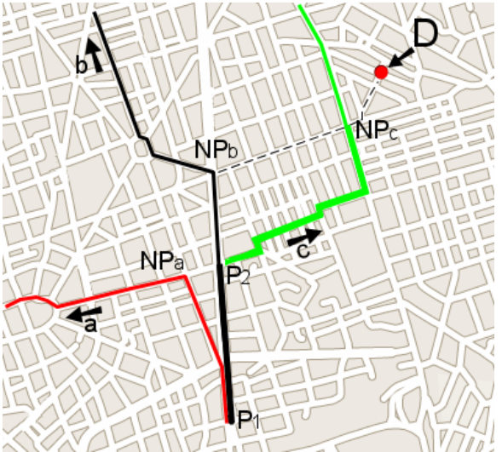
GeOpps: Geographical Opportunistic Routing
Assumes that cars know in advance their trajectory
Using some navigation, travel planner software
Next hop selected in three steps:
Each neighbor calculates for its trajectory the closest point to the destination
It calculates how much time it takes to that closest point
If the trajectory of one of the neighbors gets closer to the destination than that of the current node, then the packet is taken over
If the car changes its trajectory, everything should be recalculated

Slide 20
VANET broadcast protocols
We have a target zone, within which all the vehicles should receive the message (Broadcast Domain)
However, the load on the network should be minimized, (avoid broadcast storms)
DECA: Density-Aware Reliable Broadcasting
Does not use position information
Beacon messages sent to discover neighbors
Network load is minimized by chosing as next hop the neighbor that has most neighbors

Slide 21
Intelligent flooding through gossiping
Messages are rebroadcast or dropped with a given probability p
Carefully Localized Urban Dissemination (CLoUD)
The drop probability on a given road segment depends on the probability of cars on that segment heading towards the source of the flooding (where the danger was detected)
Needs a traffic database
Turn probabilities at each intersection
Stop probability on each segment
Average traffic density in different periods of the day
Increasing reliability with a voting mechanism
The message is dropped only if there are sufficent votes to drop it
Miklos Mate, Rolland Vida, „Reliable Gossiping in Urban Environments”, in Proceedings of 72nd IEEE Vehicular Technology Conference VTC-Fall, Ottawa, Canada, September 2010.

Slide 22
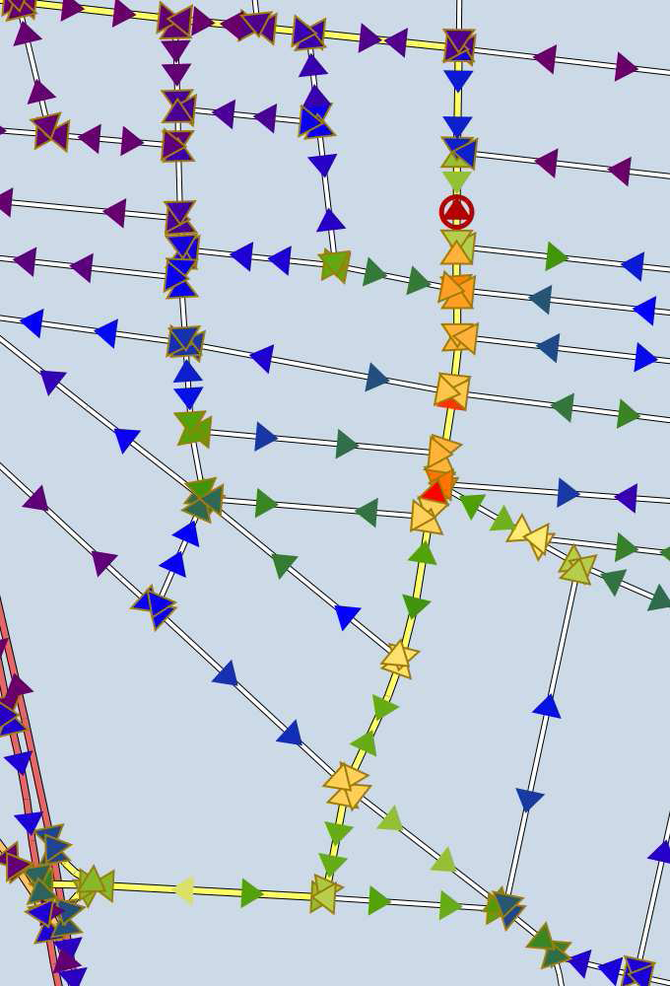
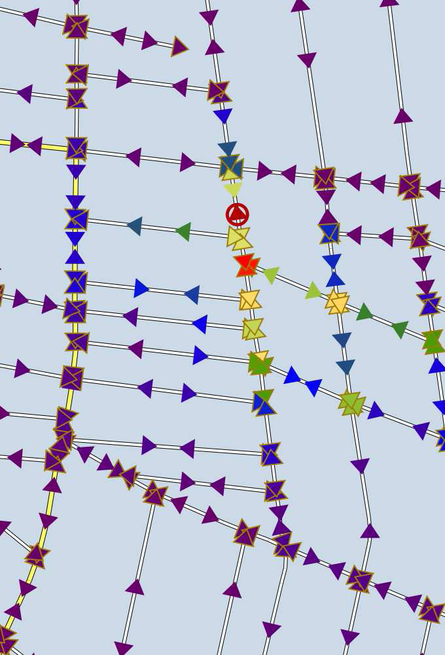
Intelligent flooding through gossiping
Simulation results for the CLoUD protocol
Digital map of Budapest, warmer colors mean more messages received by that car
If the problem occurs on a main road (left), the message is spread more broadly
If the problem occurs on a side road (right), the flooding dies out fast

Slide 23
VANET Multicast protocols
There is a given area inside which all cars should receive the message (Zone of Relevance)
The multicast group is implicitely defined by the position of the cars
The source is not necessarily inside the ZOR, so first the packet should be delivered to the ZOR, through unicast routing, and then flood the ZOR
E.g., information about traffic jam is not interesting for those already in the jam
The alert should be sent to those who can still avoid it

Slide 24
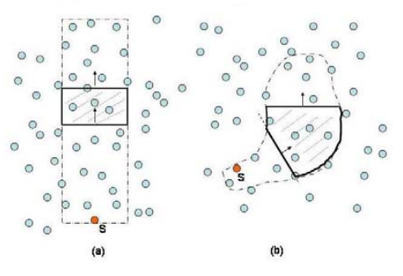
Mobicast
Mobile Just-in-time Multicasting
The Zone of Relevance, or Delivery Zone, moves with a given speed
E.g., give way to the ambulance
We should ensure that within some space-time coordinates, each car that enters the Delivery Zone should receive the message before it enters the zone, or just on entering the zone

Slide 25
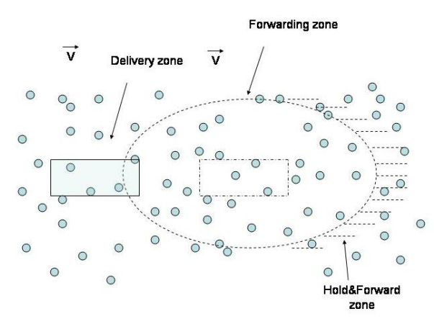
Mobicast
Forwarding Zone
Preceeds the Delivery Zone
Nodes in this zone rebroadcast the message
Hold&Forward Zone
They only store the message, and retransmit it only when entering the Forwarding Zone

